Slide 1
DAVI CA2 public transport DATA ANALYSIS
JAYDEN YAP JEAN HNG P2112790 DAAA 1B 04

Slide 2
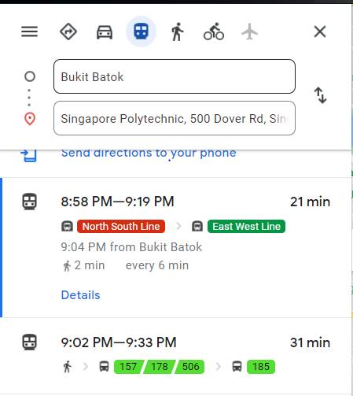
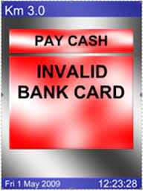
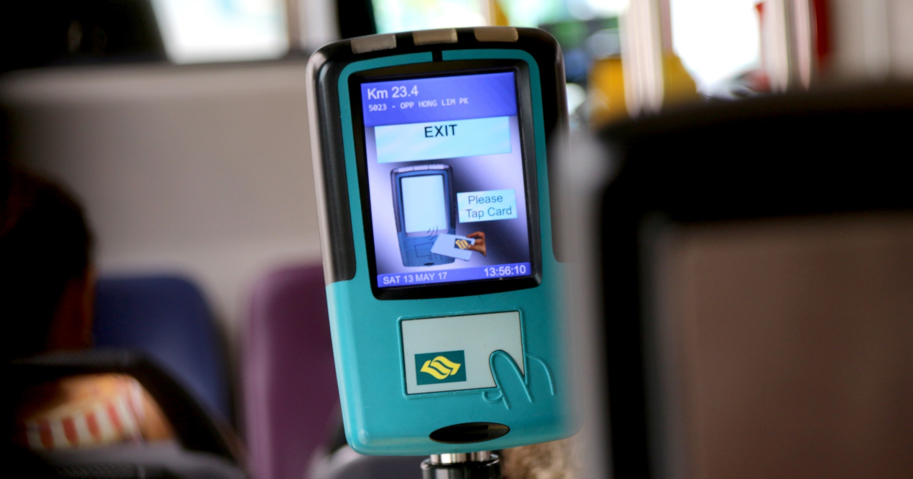
Public transport is hard
Notes:
Good morning Ms Tan, here’s my analysis on the HDB Datasets

Slide 3

If we make the wrong decision…
Notes:
Good morning Ms Tan, here’s my analysis on the HDB Datasets

Slide 4

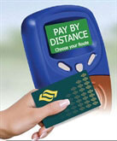
Distance-based fares introduced in 2010
Introduced to Singapore in 2010, Distance-Based fares charges based on the total distance travelled in one journey, regardless of the mode of transport used and omitting boarding charges for every trip.
To encourage flexibility in commuting patterns, a single journey allows for up to 5 transfers, so long as the transfers are made within a timeframe stipulated under DBF guidelines.
Implemented to allow for more ‘fair’ charges for commuters
Notes:
Good morning Ms Tan, here’s my analysis on the HDB Datasets

Slide 5
Let’s investigate!
Notes:
Good morning Ms Tan, here’s my analysis on the HDB Datasets

Slide 6
objectives
1. Compare our current-day Distance Based Fares (2020) against Non-Distance Based Fares (2009), to see how the fare structure affected Singaporeans’ total spendings on the daily commute
2. Investigate the different fare options available to SP Students, to see which is the most worthwhile, depending on how one travels
Notes:
My objectives for this analysis were very specific. First, analyse households by Flat Type. Secondly, analyse by ethnic group to see how cultural differences affect living. Thirdly, analyse family nucleus types. Fourthly, analyse resale prices to find out about affordability. Fifth, find relationship between size and price of flats. And lastly, analyse age to find out about Aging Population.

Slide 7
DATASET LINKS
Monthly Concession Pass Prices (2020) and (2009)
Fares for Feeder Bus Services (2020) and (2009)
Fares for MRT (2020) and (2009)
Public Transport Utilisation - Average Daily Public Transport Ridership
Notes:
Heres the datasets I used

Slide 8
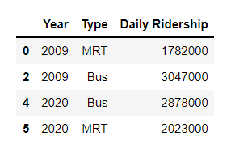
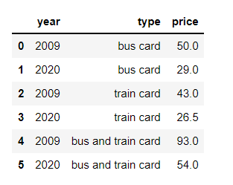
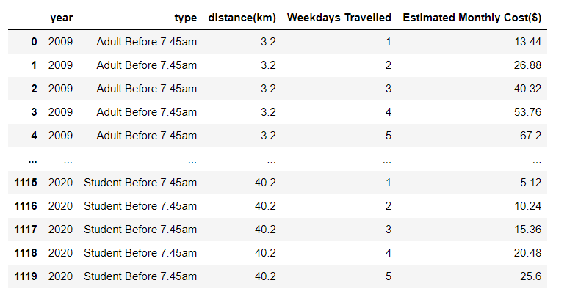
Data dictionary
Concession Pass Prices by Year and Pass Type
6 rows, 3 columns
Daily Average Ridership of Public Transport by year and transport mode (MRT and Bus)
4 rows, 3 columns
Estimated monthly travel costs by year, card type, distance travelled, and weekdays travelled
Notes:
Heres the datasets I used

Slide 9
Objective 1: Compare Distance Based Fares (2020) against Non-Distance Based Fares (2009)

Slide 10
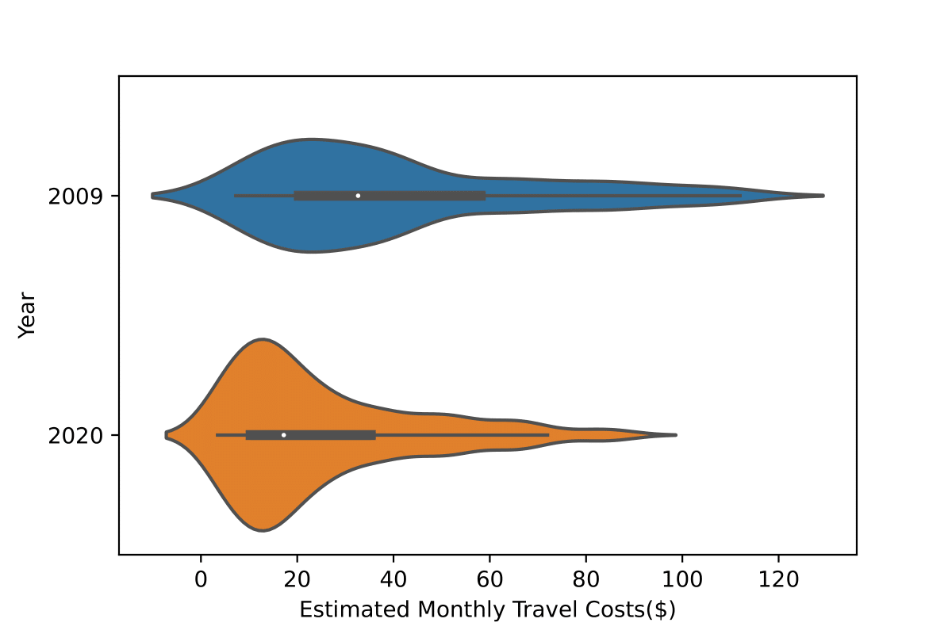
plot 1: violin plot
Using violin plot, we can see not only the 5 number summary from boxplot, but the density of data too.
Overall, travel costs in 2020 are much lower than in 2009 (median is lower)
2020 Data is much more positively skewed, while 2009 data is also positively skewed but less so
This indicates to us that:
The Ministry of Transport (MOT)’s efforts to bring commuters’ costs down have succeeded with the introduction of distance-based fares.
Majority of Singaporeans are spending less than ~$40 monthly on travel. (Q3)
Notes:
Aliases for Regions:
S Metro- South Metropolitan
E Metro- East Metropolitan
SE Metro- Southeast Metropolitan
N Metro- North Metropolitan
W Metro- West Metropolitan
E Vict-East Victoria
N Vict- North Victoria
W Vict- West Victoria

Slide 11
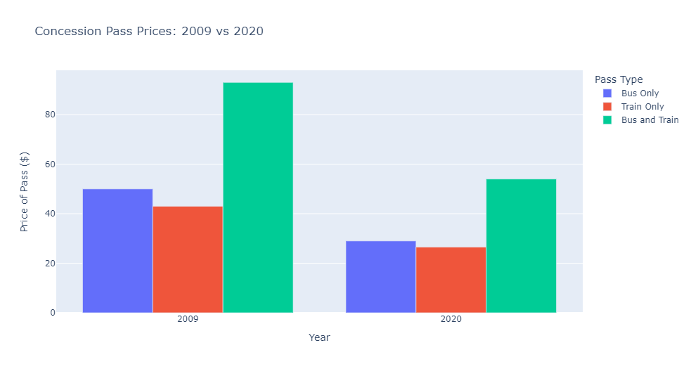
plot 2: interactive bar chart with plotly
We can see that concession pass prices have decreased overall from 2009 to 2020
Bus and train pass is about double the cost of the single passes
Therefore:
MOT made concession passes more affordable for Singaporeans
MOT’s efforts allow for commuters to spend more on other things in life
Compared to the ~$40 estimate per month we saw earlier, Concession passes for us are a little more expensive.
Hence, Concession passes should be used for people who have to travel extreme distances very often
Notes:
Aliases for Regions:
S Metro- South Metropolitan
E Metro- East Metropolitan
SE Metro- Southeast Metropolitan
N Metro- North Metropolitan
W Metro- West Metropolitan
E Vict-East Victoria
N Vict- North Victoria
W Vict- West Victoria

Slide 12
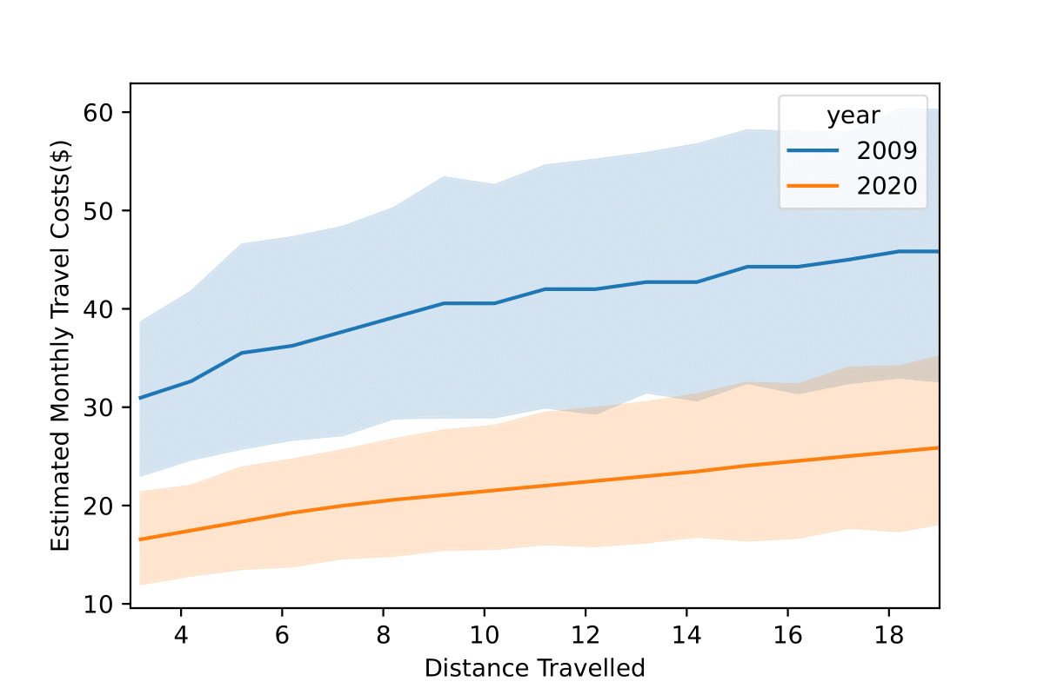
plot 3: line plot
Graph has shading because of the 2 different fare types (Adult and Student), these form the shaded outlines. Seaborn aggregates these together to form the line.
Travel costs seems to have a linear relationship with distance travelled , i.e distance travelled in a single trip
2020 costs once again, are lower than costs in 2009
Both lines have somewhat ‘mild’ gradients/slopes.
2020 line has a smaller gradient than the 2009 line
This shows that:
Technically speaking, by travelling a longer distance per trip, one would get more value for money (overall distance covered) compared to multiple separate short trips.
Distance-based fares has helped Singapore to achieve more affordable transport
Notes:
Aliases for Regions:
S Metro- South Metropolitan
E Metro- East Metropolitan
SE Metro- Southeast Metropolitan
N Metro- North Metropolitan
W Metro- West Metropolitan
E Vict-East Victoria
N Vict- North Victoria
W Vict- West Victoria

Slide 13
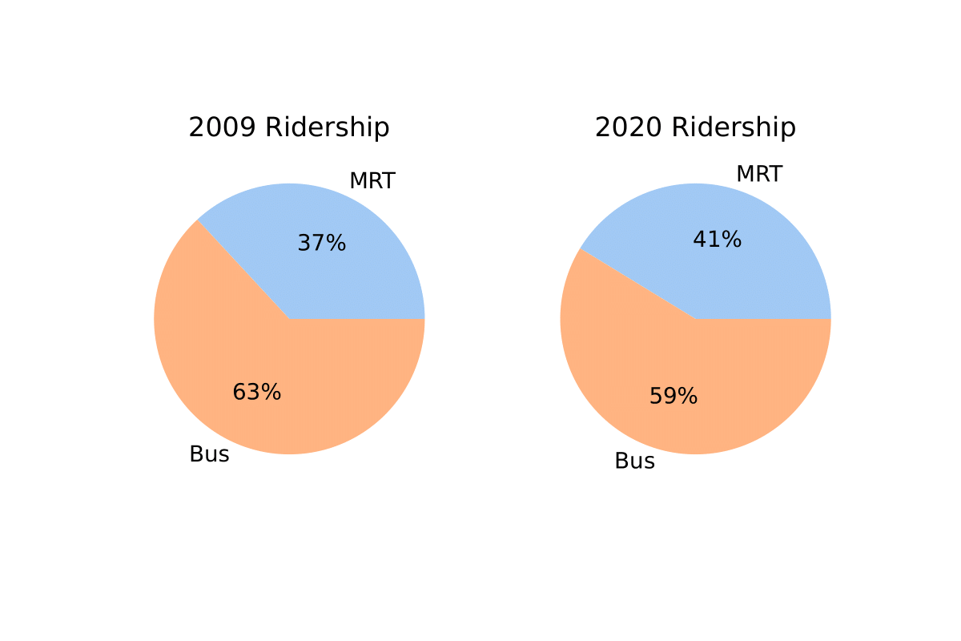
plot 4: pie chart
Bigger proportion of Singaporeans choose to use MRT after distance-based fares were implemented (2020) 37% vs 41%
Smaller proportion of Singaporeans choose to use the Bus after Distance-based fares were introduced.
In the past, people would often choose to travel just with bus and not transfer to MRT so that they would avoid the high costs of transfers
Hence, distance-based fares that eliminate these transfer costs encourage Singaporeans to use MRTs more than before
Furthermore, in the new system, if you take an expensive feeder bus (~$0.90), and then a short MRT ride (1-2 stops). Your overall cost will still be ($0.90) because the bus cost was more expensive. This encourages people to skip out on using the bus.
Notes:
Aliases for Regions:
S Metro- South Metropolitan
E Metro- East Metropolitan
SE Metro- Southeast Metropolitan
N Metro- North Metropolitan
W Metro- West Metropolitan
E Vict-East Victoria
N Vict- North Victoria
W Vict- West Victoria

Slide 14
Objective 2: Investigate the different fare options available to SP Students

Slide 15
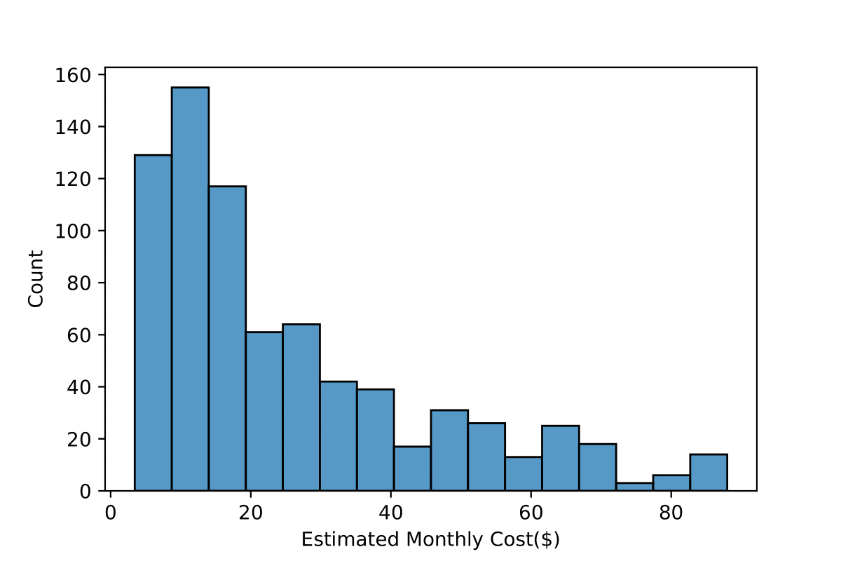
plot 5: histogram
Histogram of Estimated Monthly Cost($) Distribution for distance based fares in 2020
Distribution is heavily positively skewed
A bulk of the costs are below $20
This shows that in majority of the cases (different fare types, weekdays travelled and distance travelled), one will be spending less than $20 a month on travel!
Notes:
Aliases for Regions:
S Metro- South Metropolitan
E Metro- East Metropolitan
SE Metro- Southeast Metropolitan
N Metro- North Metropolitan
W Metro- West Metropolitan
E Vict-East Victoria
N Vict- North Victoria
W Vict- West Victoria

Slide 16
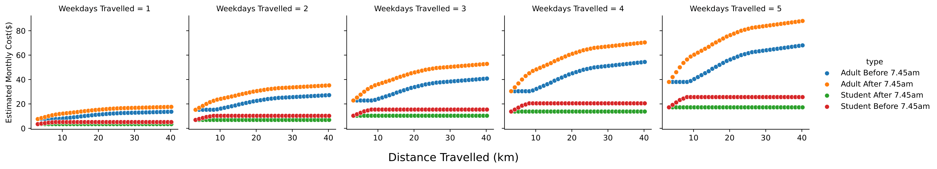
plot 6: facetgrid (scatterplot)
Using Facetgrid, we can visualise 4 variables at the same time
The more weekdays you travel, the more aggressively the costs will scale with distance.
In every case, no matter how far you travel or which time of day you travel at, Student card is much cheaper than using an adult card.
A peculiar outcome is seen where the red line (using Student Card before 7.45am) is actually more costly than the green line (using after 7.45am). This is most likely a mistake in the website’s listings as it is supposed to be a discount
Recommendations:
Always use student card if you are eligible (full time diploma student)
Travel to school before 7.45am to get big savings! You can travel early even if your class is not at that time because you can do self-study in campus.
Notes:
Aliases for Regions:
S Metro- South Metropolitan
E Metro- East Metropolitan
SE Metro- Southeast Metropolitan
N Metro- North Metropolitan
W Metro- West Metropolitan
E Vict-East Victoria
N Vict- North Victoria
W Vict- West Victoria

Slide 17
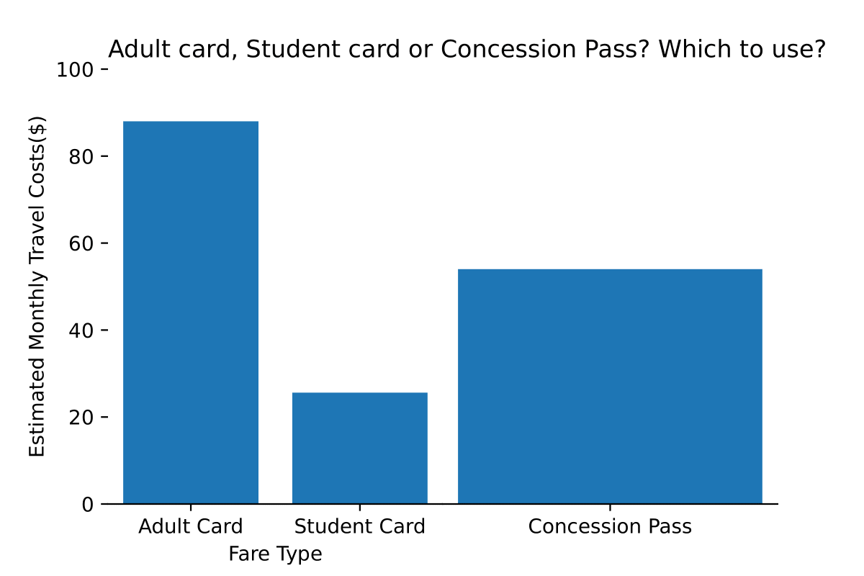
plot 7: bar chart
The costs for Adult Card and Student Card are in the Worst Case Scenario:
i.e: Highest distance travelled, travelling after 7.45am (no discount) Our purpose is to see if cost of concession pass is justified.
Student card reigns supreme as the lowest cost, so it’s the best option
However, one must be a full-time matriculated Diploma student to get Student Card
Hence, we can conclude from the graph that if one were a part-time Student and travelled a lot, they could opt to purchase the concession pass instead to save some money, instead of using adult card fares
Notes:
Aliases for Regions:
S Metro- South Metropolitan
E Metro- East Metropolitan
SE Metro- Southeast Metropolitan
N Metro- North Metropolitan
W Metro- West Metropolitan
E Vict-East Victoria
N Vict- North Victoria
W Vict- West Victoria

Slide 18
recommendations
Distance Based Fares (2020) against Non-Distance Based Fares (2009)
Ministry of Transport should continue their efforts in lowering costs for travel. Specifically, adult fare costs are very high. For people having to travel to work every day, travelling without a concession pass is very expensive. This might be leading to people to purchase cars instead which is environmentally unfriendly.
Fare options available to SP Students
SP Students should always make leverage of the Student Card, and apply for one if they have not already. The cost reductions are very high.
If an SP student is part-time and travels frequently, they cannot apply for the student card, hence, they can consider purchasing a concession pass at ~$50 every month. This way they can commute to school and/or their part-time jobs with no limits.

Slide 19

Thank you!

